Slide 1

My Child Matters Debate
Is it ethical to give adapted treatment to children in LMIC
By Pr Laila Hessissen
DEVELOPING REGIONAL COLLABORATIVE NETWORKS: THE GFAOP EXPERIENCE

Slide 2
No disclosure

Slide 3
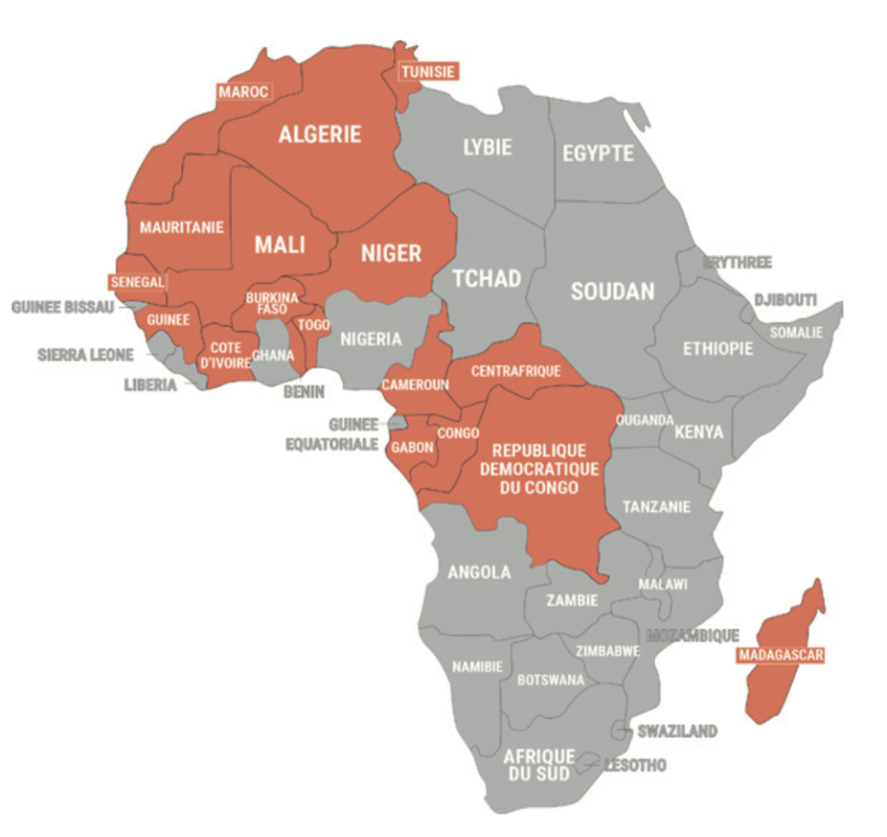
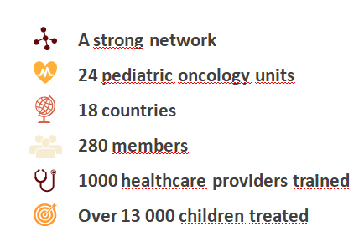
GFAOP network created in 2020

Slide 4
QUESTIONS?
What do we mean by « is it ethical ? » ?
Who is concerned ?
  PO from LMIC ?
  « experts » from HIC?
Why and when to raise this issue ?

Slide 5
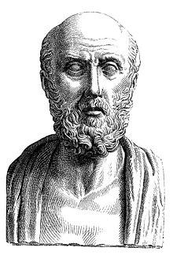
"Primum non nocere"
"First do no harm"
Hippocratic Oath

Slide 6
Ethical dilemnas
The individual level

Slide 7
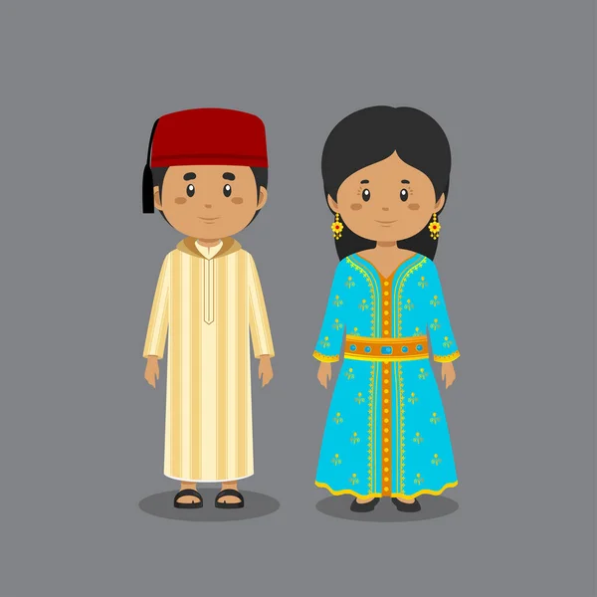
Two cases diagnosed with Burkitt Lymphoma
Good general
and
nutritional status ?
Yes
No
LMB protocol
CycloBurkitt

Slide 8
Two cases diagnosed with Hodgkin Lymphoma
Access to
PET scann?
Yes
No
European protocol
Adapted treatment

Slide 9


Slide 10
The group perspective
Ethical concerns

Slide 11
ATR Implemention in Francophone Africa
Since 2000, GFAOP has been implementing ATR
  Burkitt
  Nephro
  Hodgkin
  ALL
  Retino
Requirements for ATR implementation :
  Data collection
  ATR
  Access to essential drugs

Slide 12
1 – Data base issues
2016- Group Franco Africain d’Oncologie Pédiatrique (GFAOP) Started collecting data from 13 centres
2017- Data base housed in Gustave ROUSSY institut . Contract between GFAOP and GR for housing data.
Authorized by french authorities:
  CCTIRS N°16.274
  CNIL (N°DR-2017-349)
  CNIL (RGPD) amendement DR-2020-101 to add clinical studies to the base.
Submission to participant countries ethical commissions

Slide 13
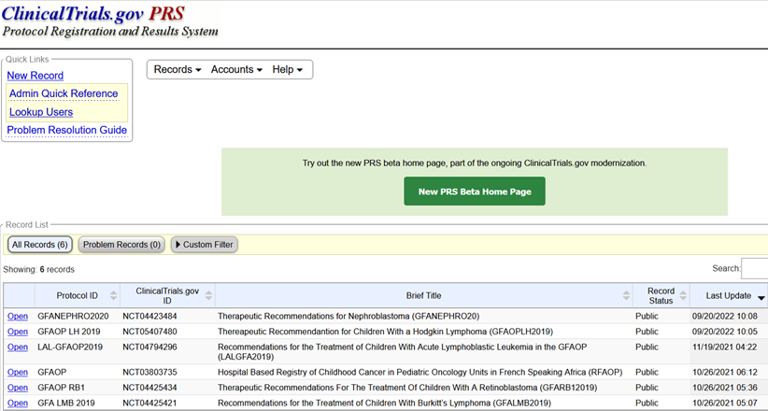
2 – Adapted Treatment

Slide 14
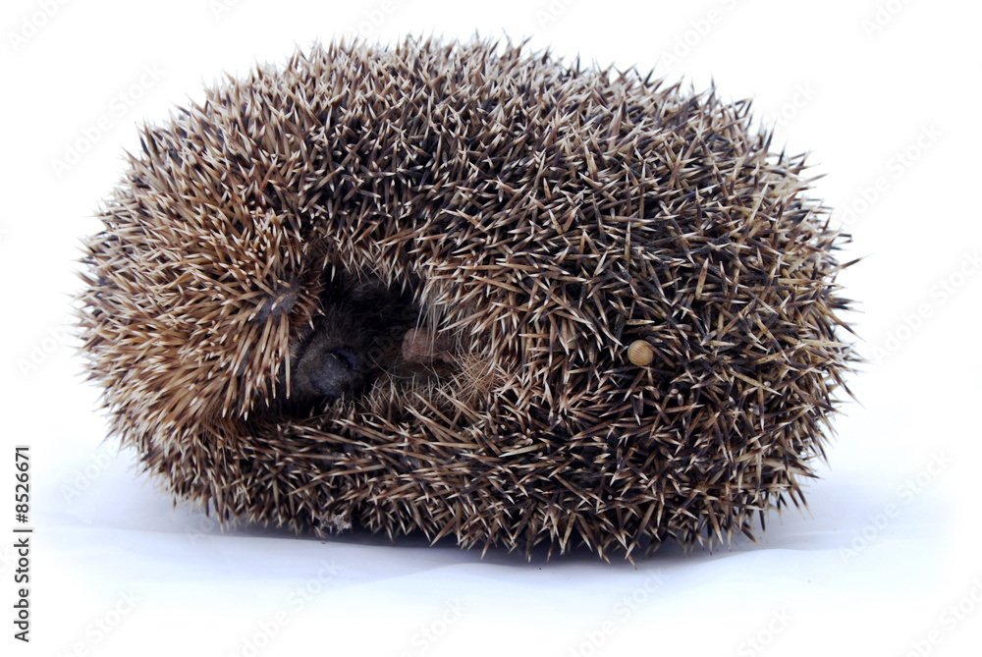
3 – Access to essential drugs
Most Challenging issue
The drug access hedhog

Slide 15
When and why to raise the ethical issue?
Because we feel that it’s UNFAIR

Slide 16


Slide 17
To conclude
Ethics is a shared responsability between HIC and LMIC
Ethics is a dynamic process

Slide 18
Just do your best and keep on going

